Slide 1

INDUSTRIAL WASTE & WASTE WATER ENGINEERING
ADITYA ENGINEERING COLLEGE (A)
By
K.P.PRAJNA BHARATHI
Asst. Professor, Dept. of CE
Aditya Engineering College(A)
Surampalem.

Slide 2
UNIT 1
INDUSTRIAL WATER QUALITY AND QUANTITY REQUIREMENTS

Slide 3
Disadvantages of Hardwater
Domestic purpose:
Washing:
When hard water is used for washing clothes, it does not produce lather with soap, but forms a white scum or precipitate.
The iron salts present in hard water cause staining or yellowing of the fabric.
The white scum or sticky precipitate of calcium stearate/magnesium stearate leaves a messy scum on the fabric that cannot be washed easily.
Bathing:
Hard water used for bathing, leaves a sticky scum on the skin, reduces the cleansing property of soap, resulting in wastage of soap.
Cooking:
Hard water when used for cooking, raises the boiling point of water, leading to wastage of fuel. Hard water forms scales at the bottom of the cooking utensils.

Slide 4
Drinking:
Drinking hard water impairs the digestive system. It can cause loss of appetite and constipation.
Consumption of hard water can lead to the formation of calcium oxalate crystals in the urinary system.
Industrial Use
Textile Industry:
Hard water does not produce lather with soap unless the calcium and magnesium ions are completely removed. Therefore, a lot of soap is used up in washing yarn, fabric, etc.
The precipitates of calcium and magnesium salts adhere to the fabrics. The iron salts in water cause yellowing/staining of the fabric.

Slide 5
Sugar Industry:
Usage of water containing sulphates, nitrates, alkali carbonates etc., in sugar refining affects the crystallization property of sugar and reducing its yield. Moreover, the sugar thus produced may be deliquescent.
Dyeing Industry:
Calcium, magnesium and iron salts dissolved in hard water reacts with costly dyes, forming undesirable precipitates. The precipitates form spots on the fabric and give poor quality of shades.
Paper Industry:
Salts present in hard water react with chemicals that are used to smoothen the paper and make it appear glossy. It also affects the colour quality of the paper.

Slide 6
Laundry:
Use of hard water in laundry consumes large amount of soap. Iron salts present in hard water causes staining/yellowing of the clothes.
Concrete Making:
The hydration of the cement and the final strength of the hardened concrete is affected by the presence of chlorides and sulphates in hard water.
Pharmaceutical Industry:
Demineralized industrial water and sterilized soft water of neutral pH is required to prepare aqueous forms of injections, drugs, ointments etc.
Use of hard water to produce such products may result in the formation of undesirable products in them.

Slide 7
Dairy Industry:
Water is a major component in dairy processing. Use of hard water in dairy industry can result in scaling in boilers and cooling towers.
The magnesium content in the water should be low, as it can affect the taste of butter.
Presence of pathogenic organisms reduces the quality of the dairy products.
Brewery Industry:
Water used in brewing industry must be of high quality as improperly treated water can affect the taste, bitterness, foamability and colour of the beer significantly.
Food Processing Industry:
The calcium and magnesium content in water should be low, as it can affect the taste of a product.
The presence of alkalinity in water neutralizes the fruit acids and changes the taste.

Slide 8
Boilers:
When hard water is used in boilers for steam generation, it forms scales on the walls of the boilers.
Other effects of usage of hard water in boilers are sludge formation, priming, foaming and caustic embrittlement.
Since, water is used as a medium for various domestic and industrial processes, it has to be fit for use and should satisfy the quality requirements.

Slide 9
Quality requirements for boiler feed water and cooling towers:
The quality of water for steam generation in boilers and cooling towers should have the following characteristics.
(i) Zero hardness (free from dissolved salts) to prevent the formation of scales.
(ii) Absence of suspended impurities.
(iii) Absence of dissolved gases (such as O_{2 ,}CO₂ ) to prevent corrosion of the boiler.
(iv) Free from turbidity, lubricants such as oil and greases, to reduce the tendency for priming and foaming.
(v) Absence of caustic alkali to prevent caustic embrittlement.

Slide 10
Boiler troubles caused by the impurities in feed water
Scale and Sludge Formation:
Scales are hard, sticky deposits formed on the inner walls of the boiler.
Sludge is the loose precipitate of MgCO₃, MgCl₂, CaCl₂ or MgSO₄ formed in the colder regions of the boiler.
The scale and sludge are good insulators of heat. They can cause overheating at localized areas leading to serious damage to the boilers.
Caustic Embrittlement:
Caustic embrittlement is a type of corrosion of the boiler due to the presence of alkali metal carbonates and bicarbonates in the boiler feed water.
In the lime-soda process, the residual Na₂CO₃ present in the softened water decomposes to produce sodium hydroxide (caustic soda) and carbon dioxide.
Na₂CO₃ + H₂O 2NaOH + CO₂

Slide 11
This decomposition makes the boiler water “caustic”.
The caustic water in the boiler enters the minute hair-cracks in the inner side of the boiler.
As the water evaporates, the iron present in the boiler dissolves to form sodium ferrate (Na₂FeO₂) and NaOH deposits in the cracks, resulting in the embrittlement of boiler parts (such as bends, rivets, joints, etc.)
Corrosion:
Boiler corrosion refers to the disintegration of boiler materials due to the following reasons,
(a) Formation of insoluble product due to hydrolysis of either salts or fatty oils.
(b) Presence of dissolved gases like O₂ and CO₂
These factors can result in component failure, produce metal oxide contamination and deposit in other parts of the boiler, which may lead to premature damage or failure.

Slide 12
Priming and Foaming:
Priming refers to the formation of wet steam in a boiler due to,
(a) Rapid boiling of feed water
(b) Presence of large quantity of alkali sulphates and chlorides in water.
Foaming refers to the formation of foam or bubbles in the boilers due to the presence of fatty oils, greases, emulsions and the other impurities.
Carryover:
The term carryover in boilers refers to picking up and carrying of impurities in water particles along with steam.
The carryover results in,
- Decreased purity of steam
- Damage to super heaters, steam turbines, or downstream process equipment.

Slide 13
Causes of scale formation
The causes of scale formation are,
(a) Decomposition of calcium bicarbonate
(b) Deposition of calcium sulphate
(c) Hydrolysis of magnesium salts
(d) Presence of silica in the boiler feed water.
Disadvantages of Scale Formation in the Boilers
(a) Fuel Wastage
Scales have a low thermal conductivity, so the rate of heat transfer from boiler to inside water is greatly decreased.
In order to provide a steady supply of heat to water, excessive or over heating is carried out and this causes increase in fuel consumption

Slide 14
(b) Reduction in Boiler Safety
Due to scale formation, over-heating of boiler is to be done in order to maintain a constant supply of steam.
The over-heating of the boiler tube makes the boiler material softer and weaker and this causes distortion of boiler tube and makes the boiler unsafe to bear the pressure of the steam, especially in high-pressure boilers.
(c) Decrease in Efficiency
Scales may sometimes deposit in the valves and condensers of the boiler and choke them partially. This results in decrease in efficiency of boiler.
(d) Danger of Explosion
When thick scales crack, due to uneven expansion, the water comes suddenly in contact with over-heated iron plates.
This causes formation of a large amount of steam suddenly. So sudden high-pressure is developed, which may even cause explosion of the boiler.

Slide 15
Need for treatment of boiler water
To increase the performance of boiler
To increase the energy efficiency
To maintain production capability
To reduce the operating costs
To increase the operational life of the device
To reduce the deposition of impurities and corrosion products.
The boiler feed water is treated in two stages
External Treatment:
It involves treatment of water before it is fed into the boiler in the following ways,
(i) Water softening to remove scale forming salts
(ii) Removal of silica
(iii)Removal of suspended matter by sedimentation, coagulation, settling and filtration
(iv) Removal of dissolved gases such as oxygen and carbon dioxide
(v) Removal of oil.

Slide 16
Internal Treatment:
It involves treatment of water inside the boiler by,
(i) Carbonate conditioning
(ii) Phosphate conditioning
(iii) Calgon conditioning
(iv) Colloidal conditioning
(v) Treatment with sodium aluminate
(vi) Radioactive conditioning
(vii) Electrical conditioning
(viii) EDTA conditioning

Slide 17
External treatment methods of boiler water
Water Softening:
Water softening is an important process to remove the dissolved solids, which are responsible for hardness of water.
The methods employed for water softening include,
1) Lime-soda process
2) Zeolite process (Permutit process/Base-exchange process)
3) Ion- exchange process (Demineralization / Deionization process)

Slide 18
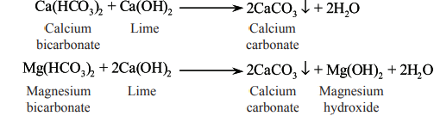
Lime-soda Process
Principle:
The soluble calcium and magnesium salts in hard water are removed by adding lime [calcium hydroxide Ca(OH)₂] and soda [sodium carbonate (Na₂CO₃)] to the water.
The soluble salts are converted to insoluble compounds of CaCO₃, Mg(OH)₂ precipitates, that can be separated by filtration.
Lime is used in the following chemical reactions,
Removal of temporary hardness

Slide 19
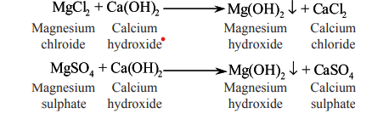
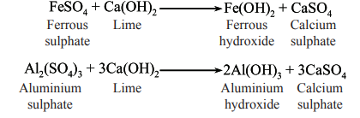
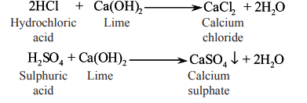
(ii) Reaction to remove permanent magnesium hardness
(iii) Reaction to remove dissolved iron and aluminium salts
(iv) Reaction to remove free mineral acids

Slide 20
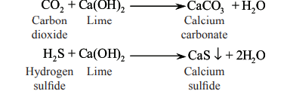
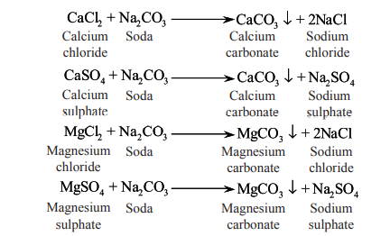
(v) Reaction to remove dissolved CO₂ and H₂S
Soda (Na₂CO₃) is used in the water-softening process to remove permanent calcium hardness in water. The reactions involved are as follows,

Slide 21
Cold Lime-soda Process
The process involves mixing of lime and soda with water as well as a small amount of coagulant (alum, aluminium sulphate, ferrous sulphate, or sodium aluminate).
The fine divided precipitate particles are entrapped because of the coagulant. Silica and oil are also removed.
Apparatus
The apparatus for cold lime-soda softener consists of the following.
(i) Outer Vertical Circular Chamber
(ii) Inner vertical circular chamber
(iii) Stirrer Paddles
(iv) Inlets
(v) Outlets

Slide 22
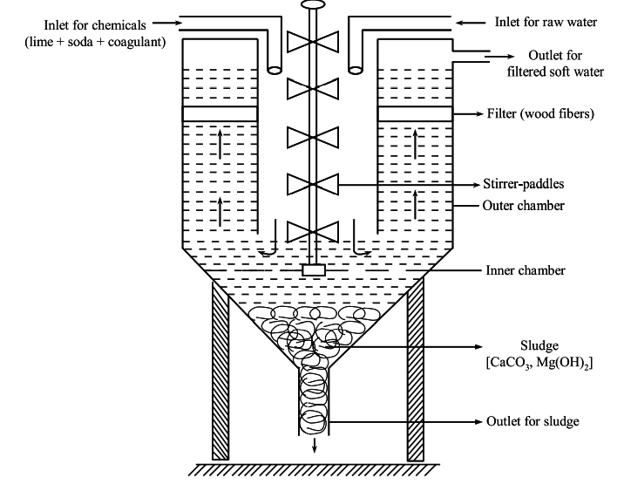
Cold Lime – Soda Softener

Slide 23
Procedure
The inner vertical chamber is fed with a calculated amount of lime, soda and a coagulant along with raw water through the inlet pipes.
The stirrer paddles enable stirring and continuous mixing of the components of the inner chamber.
The insoluble precipitate (sludge) formed, following the chemical reactions, settles down to the bottom of the apparatus which can be removed from time to time through the outlet at the bottom of the vessel.
The softened water passes through the filtering media of the outer chamber to remove the sludge completely.
The filtered softened water flows out through the outlet pipe of the outer chamber.

Slide 24
Hot Lime-soda Process
Apparatus
The apparatus for hot lime-soda softener has the following components.
(i) Reaction tank
(ii) A conical sedimentation tank
(iii) Sand filter
(iv) Inlets
The apparatus has three inlets,
Raw water feed inlet
Chemicals inlet
Superheated steam inlet.
(v) Outlets
The apparatus has two outlets,
One outlet of softened water
The other outlet for removal of precipitated sludge.

Slide 25
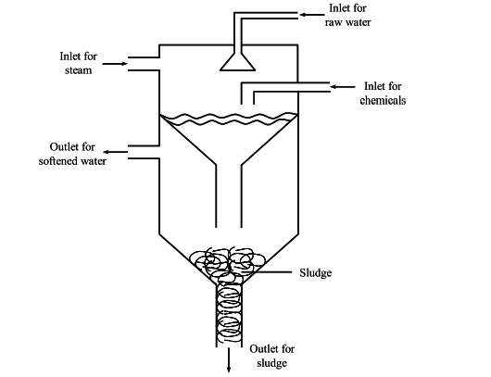
Hot Lime – Soda Softener

Slide 26
Procedure
The reaction tank is fed with raw water and mixed with a calculated amount of lime and soda.
Super heated steam is allowed through an inlet in reaction tank to heat the mixture to form softened water.
The softened water and sludge formed in the reaction tank pass into a conical sedimentation vessel.
The insoluble precipitate in the form of sludge settles down at the bottom which can be removed from time to time.
The softened water is made to pass through another chamber containing layers of sand filter (called as sludge blanket) to remove the sludge completely.
The filtered softened water flows out through the outlet pipe.

Slide 27
Zeolite Process (Permutit Process/Base-exchange Process)
Zeolites are microporous, crystalline solids of hydrated sodium alumino silicate minerals with molecular formula Na₂O.Al₂O₃. x SiO₂.y H₂O, where x = 2 to 10 and y = 2 to 6. Such complex compounds are also referred as ‘Ion exchange resins’.
The pores and cavities are arranged in a regular array, with large internal surface area to enable adsorption of large amount of substances.
Types of Zeolites
(i) Natural zeolites Eg: Natrolite, Laumontite
(ii) Synthetic zeolites Eg: Permutit.
The pores of the zeolites have alkali-metal cations that can be replaced by other type of metal. When sodium zeolite-A is placed in hard water, the calcium ions present in hard water are trapped in the zeolite pores. The sodium ions leave the pores due to displacement by calcium ions, and make the water soft.

Slide 28
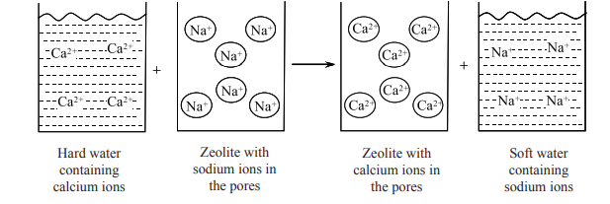
Zeolite process

Slide 29
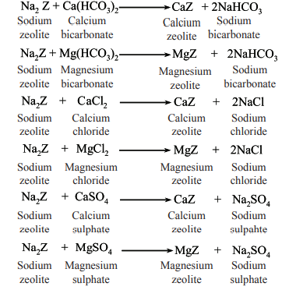
Procedure
The apparatus for zeolite process of water softening consists of a cylindrical tank containing a bed of zeolite.
Hard water containing calcium ions (Ca²⁺) and magnesium ions (Mg²⁺) is introduced into the tank through an inlet pipe.
The hardness causing ions of Ca²⁺ and Mg²⁺ are trapped/adsorbed by the zeolite as calcium zeolite or magnesium zeolite, while the sodium ions are displaced into the water making it soft.
The reactions involved are,

Slide 30
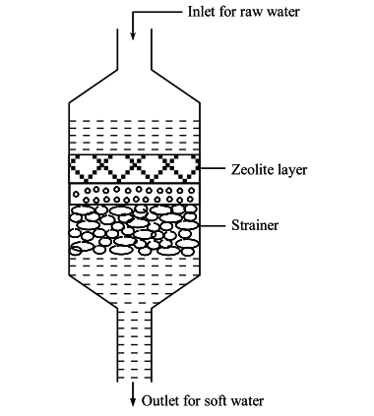
Zeolite softener

Slide 31
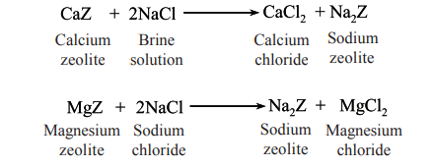
When the zeolite is saturated i.e., when all the sodium ions have been used up and replaced by calcium and magnesium ions, it is regenerated by treatment with concentrated brine (10% NaCl) solution.
The sodium salt of zeolite is formed, while the calcium and magnesium ions are forced out of the zeolite. Sodium thus formed, can be reused for softening the hard water.
Regeneration Reaction

Slide 32
Ion-exchange Process (Demineralization/Deionization Process)
The process involves the use of ion-exchange resins, such as polystyrene-divinylbenzene (PS-DVB) or polymethacrylic acid-divinylbenzene or phenol-formaldehyde polymer.
The ion-exchange resins are of two types, based on the functional group,
(i) Cation-exchange resins
(ii) Anion-exchange resins
The functional groups of cation-exchange resins are the acidic groups such as sulphonic acid (SO₃ ⁻ H⁺) or carboxyl (– COO–H⁺) to replace H⁺ ions for other cations in the water (such as Ca²⁺, Mg²⁺,Na⁺).

Slide 33


The cation-exchange resins are represented as RH, where R represents the resin network.
Following the treatment of water with cation-exchange resin, the liberated H⁺ ions in water will associate with anions in water, resulting in the formation of acidic water.
The acidic water is neutralized or treated with anion-exchange resin to remove the anions (such as Cl–,SO₄²⁻ , HCO₃⁻) and release the OH– ions.
The H⁺ ions and OH– ions formed from cation and anion exchange resins combine to form water.
Water, thus formed is called demineralized/deionized water, which is free from cations and anions

Slide 34
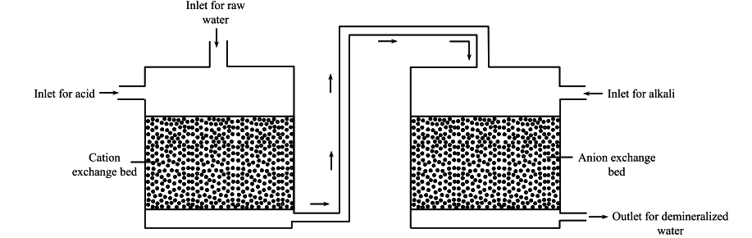
Apparatus
The apparatus for demineralization of hardwater by ion exchangers consists of two cylindrical tanks, both interconnected with a pipe.
One of the tanks contains cation exchange bed, while the other tank has anion exchange bed.
The hard water (raw water) is allowed to pass through the inlet pipe to cation exchange bed.

Slide 35



The following chemical reactions occur,
The treated water is passed through anion exchange resin tank. The following chemical reactions occur,
The H+ ions formed from cation exchanger treatment and OH– ions from anion exchanger treatment combine to form water

Slide 36

When the cation exchange bed and anion exchange bed is saturated, the regeneration becomes necessary. The saturated cation exchange bed is regenerated by passing dilute hydrochloric acid or sulphuric acid solution (2% HCl or H₂SO₄).
Regeneration reaction
The saturated anion exchange bed is regenerated by passing dilute sodium hydroxide solution.
RCl + NaOH ROH + Nacl
R₂ SO₄+ NaOH 2ROH + Na₂ SO₄
R₂ Ca + HCl 2RH + Cacl₂
R₂ Mg + HCl 2RH + Mgcl₂

Slide 37
Removal of Silica
The presence of silica in the boiler water can result in the formation of silicate scales of calcium silicate and sodium aluminium silicate.
Silica in boiler water can be removed by,
(i) Pretreatment with MgO or dolomitic lime
(ii) Conversion of SiO₂ to Si F₆²⁻ and its subsequent removal by anion exchangers.

Slide 38
Removal of Suspended Matter
The suspended matter in the boiler water can be removed by,
(i) Sedimentation:
The large suspended solids in boiler water can be removed by sedimentation in settling tanks.
(ii) Clarification:
This method is used to remove coarse, dispersed, suspended solids and colloidal impurities from feed water. The clarification of feed water is done using clarifiers with the help of coagulants and flocculants.
(iii) Filtration:
The remaining suspended solids are removed by passing water through filter bed of porous material.

Slide 39

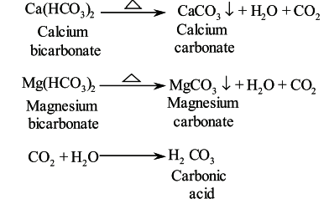
Removal of Dissolved Gases
The presence of dissolved oxygen and carbon dioxide cause pitting and corrosion of boiler material. Therefore, they need to be removed from the boiler feed water.

Slide 40


The dissolved oxygen in the feed water can be removed by using oxygen scavengers in the form of sodium sulphite and hydrazine.
Sodium sulphite is an unstable chemical, which when combined with oxygen forms a stable chemical, sodium sulphate.
Sodium sulphate is removed from the boiler by blowdown. Blowdown refers to forced ejection of solids of suspensions from the boiler at regular intervals.
Oxygen can be scavenged from boiler feed water using hydrazine. The chemical reaction involved is,
Some more examples of oxygen scavengers include tannins, hydroquinone/pyrogallol based derivatives, hydroxylamine derivatives, ascorbic acid derivatives, etc.

Slide 41
Deaeration
The dissolved oxygen from the boiler feed water is removed by the process of deaeration using mechanical deaerators.
In this process, the boiler feed water is sprayed on to perforated plate fitted tower, under low pressure.
The sides of the tower are heated by passing steam inside the steam jackets.
Under these conditions (i.e., high temperature, low pressure and large surface area) the dissolved oxygen is released into the steam, which is removed from the equipment by venting.

Slide 42
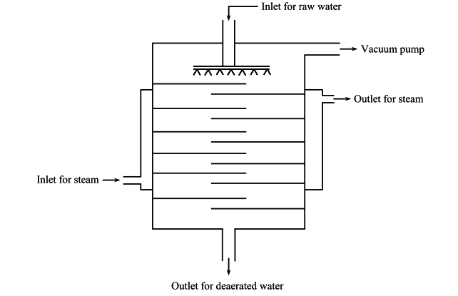
Mechanical Deaerator

Slide 43
Removal of Oil
The boiler feed water must be free of oil to prevent the formation of heat insulating oil film in the boiler tubes.
Apparatus
The apparatus for removing oil from the feed water consists of the following,
(i) A circular mixing tank with two inlets and one outlet. One inlet for passing raw water into the tank, and another inlet for passing a mixture of alum and soda ash. The outlet is meant to collect water removed of oil.
(ii) Agitator
An agitator is suspended from the top portion of the tank for constant stirring of its contents.

Slide 44
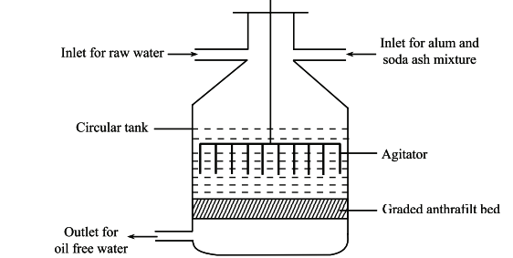
Oil Removal from Feed Water

Slide 45
Procedure
The mixture of alum and soda react with oil in raw water to form a floc.
The mixture is made to pass through the graded anthrafilt bed.
The floc adheres to the filter bed and the oil-free water is passed out through the outlet.
The anthrafilt bed is cleaned by treating with hot sodium hydroxide solution which dissolves the floc. The cleaned filter can be reused again.

Slide 46

Internal Treatment of Boiler Water
The undesirable components present in water after external treatment are removed by internal treatment of boiler water in the following ways
Carbonate Conditioning:
In this method, sodium carbonate is added to boiler water to facilitate the formation of calcium carbonate.
The scale-forming impurities precipitate in the form of loose sludge, that can be easily removed by the blow-down operation.
Blow-down operation is a method in which loose sludge is eliminated from the apparatus by compressing air under high pressure.

Slide 47
Phosphate Conditioning
The formation of scales in high pressure boilers can be prevented by the addition of sodium phosphate to the boiler feedwater.
Phosphate reacts with Ca²⁺, Mg²⁺ salts in alkaline medium (pH 10.0 – 11.5) to form insoluble compound of calcium and magnesium salts as easily removable soft sludge, which is to be removed periodically from the boiler.
The various forms of phosphates used in this process are,
(i) Alkaline trisodium phosphate - Na₃PO₄ - for acidic waters
(ii) Disodium hydrogen phosphate - Na₂HPO₄ - for neutral waters
(iii) Sodium dihydrogen phosphate - NaH₂PO₄ - for alkaline waters
(iv) Sodium pyrophosphate - Na₄P₂O₇ - for alkaline waters
(v) Sodium metaphosphate - NaPO₃ - for alkaline waters

Slide 48
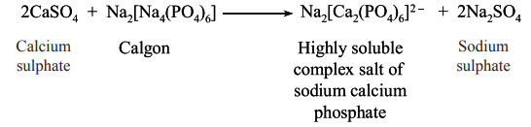
Calgon Conditioning
In this method, Calgon, a commercial name for (NaPO₃)₆ sodium hexametaphosphate, is added to the boiler feed water to form a highly soluble, complex salt of sodium calcium phosphate anion, which can be removed during blowdown operations.
Since calcium and magnesium ions are not precipitated, no scale or sludge is formed.

Slide 49
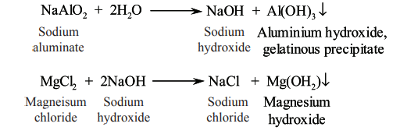
Colloidal Conditioning
Scale formation in the boiler can be prevented by the addition of colloidal conditioning agents such as starch, tannin, agar-agar, seaweed extracts or kerosene.
These substances form a slippery coating over the scale-forming particles to yield a loose and non-sticky sludge which can be removed during blow-down operations.
Treatment with Sodium Aluminate
In this process, the boiler feed water is treated with sodium aluminate (NaAlO₂).
It undergoes hydrolysis to produce sodium hydroxide (NaOH) and aluminium hydroxide [Al(OH)₃] – a gelatinous precipitate.
The precipitates of aluminium and magnesium hydroxides trap the finely suspended and colloidal impurities such as silica particles and oil droplets. These are then removed during blow-down operations.

Slide 50
Radioactive Conditioning
Radioactive substances in the form of tablets are added to the boiler feed water. The radiation energy given off by radioactive substances prevent scale formation.
Electrical Conditioning
In this method, mercury placed in sealed glass tubes and connected to a battery, rotates in the boiler. The electrical discharges emitted from the mercury bulb prevents scale formation.

Slide 51
EDTA Conditioning
In this method, 1.5% alkaline solution of ethylene diamine tetracetic acid (EDTA) is added to the boiler water to prevent the scale and sludge formation.
EDTA binds to the scale-forming cations (Ca²⁺, Mg²⁺ ions) to form stable and soluble complex salts.
Therefore, calcium and magnesium ions do not precipitate on boiler tube walls.

Slide 52
Cooling water:
The cooling water used in industrial sectors is an important medium for heat transfer from the equipment.
Thus, the excess heat is transferred from one medium (i.e., equipment) to another medium (i.e., water), basically to remove heat from the system.
The cooling water systems are of two types.
Once Through Systems
Recirculating Cooling System

Slide 53
Once Through Systems
In this type of cooling water system, the cold water is pumped from the source water body (namely, rivers, lakes and wells) which passes through the condenser/heat exchanger system.
The heat from the equipment is absorbed by the water, which is then released/discarded to the source water body at increased temperature.
This method needs enormous volume of water at considerably low temperatures.
The disadvantages of this type of system are,
Large volumes of water are needed for the cooling process.
(ii) Loss of base metal by corrosion and its release as suspended solids.
(iii) Deposit of scales on the inner walls of the pipes.
(iv) Proliferation of biological organisms can impede heat transfer, induce corrosion of equipment and restrict the flow of water.

Slide 54
Recirculating Cooling System
In this method, water is pumped from a source water body and used to cool the process equipment.
The same water is circulated repeatedly for additional cooling cycles to enable
the plant to operate at maximum efficiency.
After each cycle of cooling, the heat from the water is removed by either of the three methods:
(i) Cooling ponds/cooling canals.
(ii) Mechanical draft evaporative cooling towers.
(iii) Natural draft evaporative cooling towers.

Slide 55
Open Recirculating System
In this type, the same water is circulated repeatedly.
After each cycle of cooling, the heat absorbed by the water is dissipated through evaporation by the use of cooling towers, spray ponds, evaporative condensers, so that water may be reused.

Slide 56
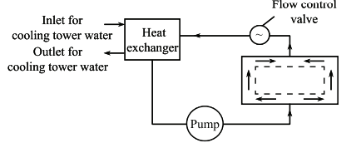
Closed Recirculation System
In this type, the cooling water is circulated repeatedly in a closed loop without exposure to the atmosphere.
Heat exchangers are used for exchanging heat from water with the atmosphere and thus help to rid the unwanted heat generated by the equipment.

Slide 57
Quality criteria of Industrial water
The principal function of much industrial water is to remove heat from process operations.
Quality of water used in processing depends on the type of process.
For example:
Manufacturing of pharmaceuticals and semiconductors demands high purity waters.
Manufacturing of high quality art papers demands potable water completely free from turbidity and colour.

Slide 58
The quality of industrial water is addressed in terms of the norms listed below
Its potential for causing damage to equipment
Problems it may cause in the manufacturing process
Impairment of product quality
Complexity of waste handling as a result of using water of the quality available

Slide 59
Quality Requirements of Process Water for Textile Mills
A number of creditable studies reveal that the textile mills in India use large amount of water, to the tune of 1.6 million liters to produce 8,000 kg of cloth per day.
The different processes in textile mills which consume water include the following,
- Bleaching
- Dyeing
- Mercerizing
- Printing
- Spinning
- Weaving
- Finishing
- Air conditioning (humidification and dust removal) and
- In Boilers.

Slide 60
Since the textile mills use large amount of water, the water should be devoid of impurities like iron, calcium and magnesium salts, as they may create problems in dyeing and finishing.
Generally, the water is treated by using simple sodium ion-exchangers to get the desirable water quality.
The recommended water quality for textile mills, according to the BIS [IS201 - 1964] is tabulated below.
Characteristic | Tolerance
Colour | 5-20 Hazen units
Turbidity | 5 silica scale
pH | 6-7.5
Total Hardness | 50 ppm
Iron | 0.25 ppm
Manganese | 0.10 ppm

Slide 61
Quality Requirements of Process Water for Food Processing and Brewery Industries
The food processing and brewery industries use water extensively for various operations such as hydraulic conveying, heating, cooling, rinsing, dissolving, dispersing, blanketing, diluting, separating, cleaning, sanitation and boiler feed water steam generation.
Hence adequate supply of potable water must be made available for such activities.
Water Quality in Food Processing and Breweries
The purity of potable water is essential in food processing and breweries for the following reasons,
(i) The hardness in water can result in scale formation (precipitation of limestone on the boiler heat area) on the surface of the equipment, which in turn, reduces the efficiency of heat exchange.

Slide 62
(ii) The minerals in water may reduce the ability of water to dissolve and disperse the food ingredients.
(iii) Water should be clear, colourless, tasteless and odourless because the quality of water affects the texture, shelf stability, appearance, aroma and flavour of food.
(iv) The total dissolved solids (TDS) in water may increase the electrical conductivity.
(v) The dissolved gases (such as oxygen) in water cause corrosive reactions due to its high oxidation potential.
(vi) The increased concentration of nutrients and organic matter in water cause microbial growth on the surface of the equipment.

Slide 63
The quality of the boiler feed water has to meet the required standards. Therefore, a number of water treatment processes are carried out.
These include the following,
Chemical treatment
Sand bed filtration
Chlorination
Carbon treatment (to remove ozone, chlorine, organic contaminants)
Ultrafiltration
Reverse osmosis
Deionization etc.,

Slide 64
Quality Requirements of Process Water for Power plants
Power plants use water for cooling system, boiler feed and ash disposal along with domestic use and plantation, the demand of water is increasing significantly.
Water Quality in Power plants
Demineralized water is used as make up in boiler and its characteristics properties are presented below.
The specific parameters such as pH (7.5 – 9.6), conductivity ( 1 µS/cm), dissolved oxygen (0.04 mg/l), alkalinity (carbonate free), hardness (0.3 mg/l), silica ( 0.5 mg/l) and Oil and grease (free) are desirable for boiler feed water.

Slide 65
The cooling circulation water should not exceed the corrosion and heat exchange influencing parameters such as pH (6.2-8.2), conductivity (80 µS/cm), chloride (200 mg/l), sulphate (200 mg/l), methyl orange alkalinity (100 mg/l), total hardness (200 mg/l), Fe ( 1 mg/l), Cu (0.3 mg/l), ammonia (0.1 mg/l), residual chlorine (0.3 mg/l) and sulphide ( free).
The following key technologies are ideal for use with power plant water treatment solutions:
• Filtration
• Reverse osmosis (RO)
• Demineralization
• Continuous electro-deionization (CEDI)
• Combined pre-treatment (RO and CEDI)
• Mixed bed ion exchange

Slide 66

Industrial Water Demand
75% of industries use only 2% of total water demand where as 5% of industries utilizes 75% of total water demand.
The major water users are steel, petroleum products, paper, and beverage industries.
The water used for cooling, steam generation, processes, utilities, and wash water in industries.
Out of these, 95% of water is used for cooling or condensation purposes of total industrial intake for the industries like thermo electric power industry.
In industries other than thermo electric, 65% of total intake used for cooling, 30 % for processing, 5% for boiler feed waters, sanitary services and other purposes.

Slide 67
The proportion of water use varies with the nature of industry.
For example, leather industry uses 5% for cooling and whereas petroleum and coal industries use 85% for cooling
In additional water demand is met through recycled flows within industrial plants.
In general, Recycled water average is 35% in any industry. which varies from industry to industry.
Increasing water consciousness, regulatory norms in all industries reduces the water intakes and waste water discharges.
The variations can be attributed to many factors, including differences, in process used even to make similar products.
Technology also plays an important role in water demand

Slide 68
The industry demand will fluctuate with the nature and magnitude of such industry and quantity of water required for unit production.
The potential of industrial expansion should be carefully investigated, so that adequate water supply can attract such industries and add to economic property of the community.
The industrial demand affected by many factors such as cost and availability of the water, waste disposal problems, management and types of processes involved.
Industrial studies of the water requirement of a specific industry should be depending on their location.
Losses and wastage: A significant quantity portion of water that enters the distribution system at the water treatment plant that does not finally reach the consumer.
This is due to leakage of faulty pipe joints, faulty valves etc.

